Slide 2
Downtown Framingham is Urban
What are the characteristics of urban areas?

Slide 3
Mission
Tagline:
building business, community and culture
Mission:
Downtown Framingham, Inc. is an independent 501(c)(3) non-profit dedicated to serving both people and local businesses by creating the most vibrant and socially engaged area in the MetroWest.

Slide 4
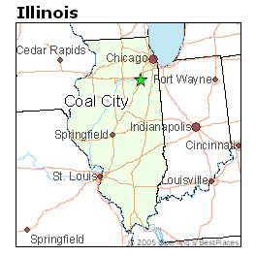
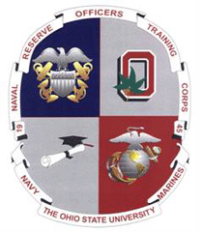
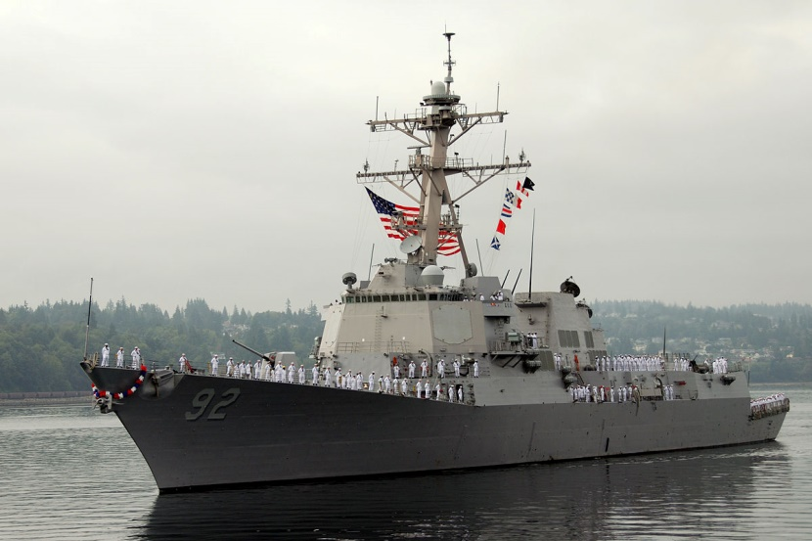
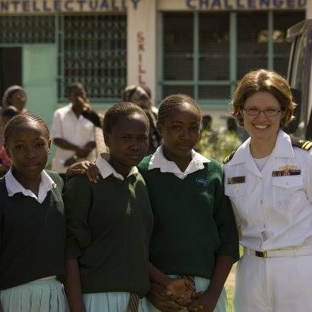
Courtney Thraen, Executive Director

Slide 5
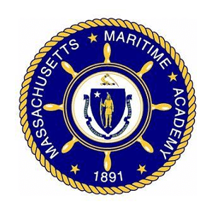

Slide 6
Main Street America Model MISSION -> VEHICLES
AREA PROMOTION
ECONOMIC VITALITY
ORGANIZATIONAL PARTNERSHIPS
URBAN DESIGN
MARKETING - DAILY
BIZ SUPPORT - WEEKLY
EVENTS – WEEKLY
PLACEMAKING / BEAUTIFICATION

Slide 7
Top 2019 Goals & Progress
January 2019 | October 2019
Host summer engagement workers | 4-week engagement pilot project
Create a sidewalk ordinance | October 29 - Council passed a motion to move the ordinance the second reading on October 29
Install wayfinding signage pointing to parking lots | Yard signs installed early October
engage the adjacent neighborhoods to determine prioritization of walking paths from local neighborhoods to the Central Business and Manufacturing districts | No action on walking paths Met with WalkBoston Do a “cars last” campaign? Incentivize Waverly St. East with shrubs

Slide 8
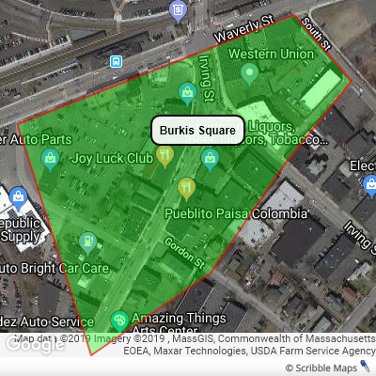

Slide 9
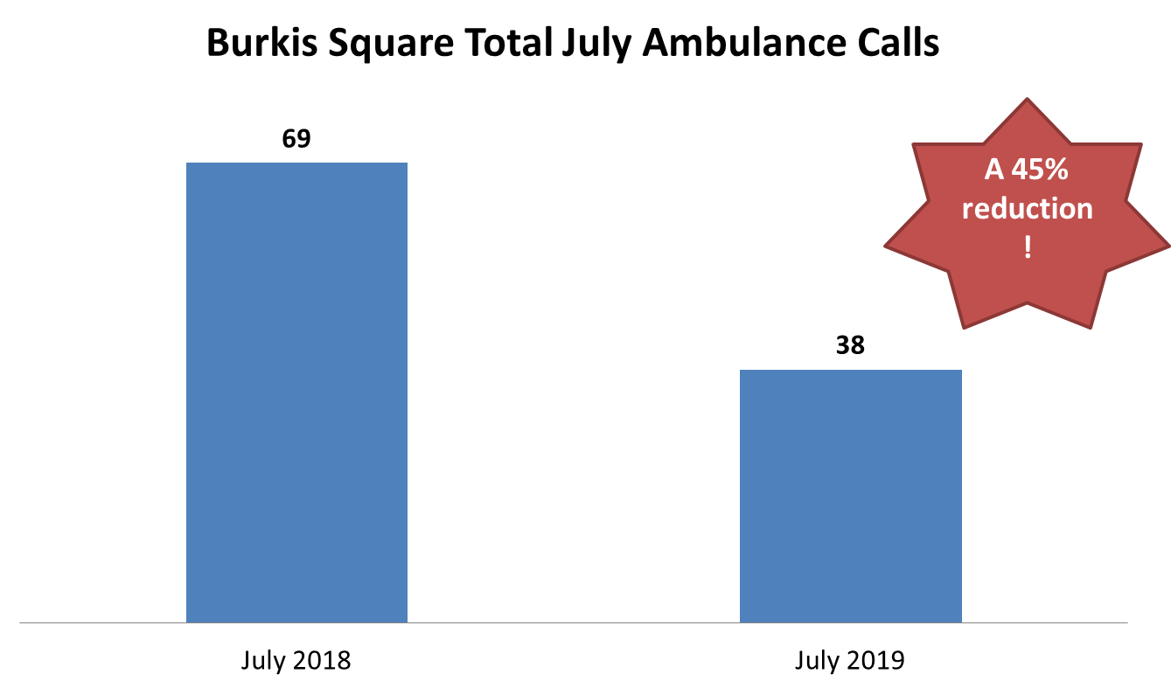

Slide 10
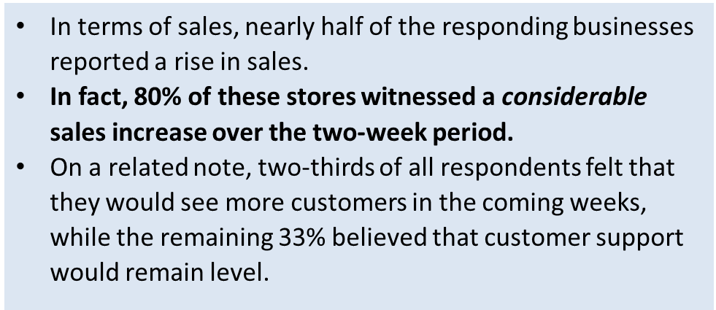

Slide 11
Top 2019 Goals & Progress
Jan 2019 | Sept 2019
create a platform to implement the Downtown Discount Program | Need staffing for DT Discount Program-- - 4 weeks of deals in November
Small business technical assistance Create Biz Resource Center Translate Workforce Training curricula with training coaches Storefront and space design consultations | Grant request to be submitted next week to launch these tools in 2020
Install 2 new murals with FPS and 7 photo wraps on local utility boxes | Completed 2 murals and 7 utility boxes

Slide 12
Other 2019 Accomplishments
350-ft landscaping project across from MBTA
Installed two art galleries at Neca’s Bakery, Sofa Cafe
“Welcome to Downtown” Vinyl Wraps at 407 Waverly
Secured MCC Grant Funding for 2020 music concerts at 301 Howard Street (bands, beer, birch trees)
Remediated graffiti in two locations
Commercial own/lease list on website
Business Attraction Strategy and Business Welcome Guide
Downtown Shopping Map
Supported full apt leasing at Amsden Apts
6 downtown storefronts qualified for MA incentive program

Slide 13
MARKETING DRIVES ENGAGEMENT/AWARENESS
Facebook Groups, eDemocracy, MWDN
Organizational Calendars
VIRTUAL VS IN-PERSON
TANGIBLE CHANGES – new businesses, infrastructure changes, promotions, etc.
 | Dec-17 | Sep-18 | Sep-19
Facebook Likes | 1598 | 2310 | 3039
Twitter Followers | 1343 | 1621 | 1787
Instagram Followers | 212 | 589 | 1039
LinkedIn DFI Group |  |  | 30
Facebook DFI Group |  |  | 667
Website Visits (YTY) | 15500 | 17000 | 20200
Mailchimp Listserv | 1025 | 1889 | 2756
Google Last Quarter Views |  |  | 5100

Slide 14
Economic Vitality -> Small Business Support
Surveys
- Biz Climate Survey
- Marketing Survey
Individual Business Consultations
- Staffing
Canvassing
- Policy Issues
- safety and parking
- City Meetings
See 2018 Business Climate Report and 2019 Marketing Report

Slide 15
2020 Biz Support Opportunities
Challenges
Micro-business staff can’t leave store
Antiquated business models
Lack of marketing, no means to gauge ROI/ROA
Opportunities
Viable business models, compelling storefronts
Websites for all businesses
Off-site workshops
Business Resource Center, workforce certifications
TOD Study – area workforce retention

Slide 16
Small Business Measureable Outcomes

Slide 18
From 2017 to 2018, the number of new businesses rose from 10 to 16, and increase of 70%.
From 2017 to 2018, the number of new businesses to fill storefronts that had been vacant for one year or longer rose from 5 to 11, an increase of 120%.

Slide 19
Top Business Concerns
Parking
Relationship between on- and off-street parking
Employment and Turnover
Safety
Foot Traffic

Slide 20
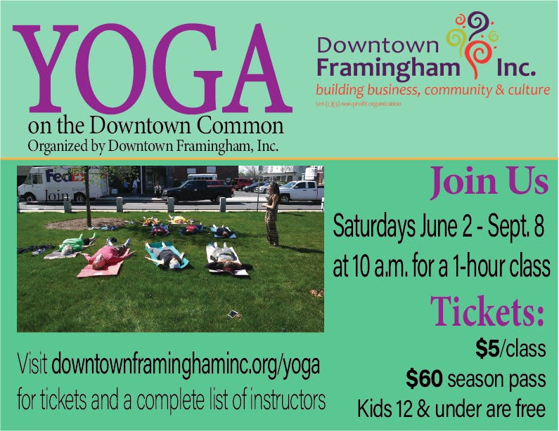
EVENTS = business-based, social-capital drivers

Slide 21
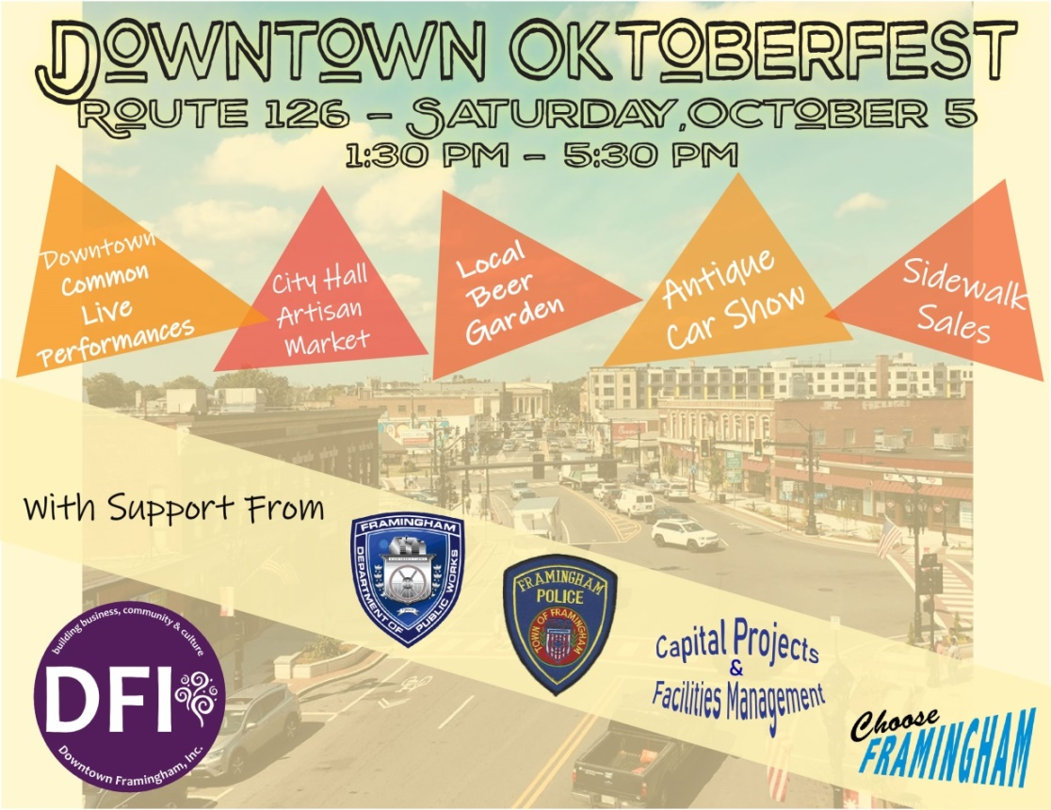
Major Seasonal Events
Celebrate6 Marathonfest
Taste of Downtown
Oktoberfest
Downtown Celebration

Slide 22
2020 Events
Shamrock Stroll & Shuttle – March 14
Celebrate6 Marathonfest – April 20
Taste of Downtown Framingham – April 26
Spring Restaurant Week – Apr 26 – May 2
Jack’s Abby / DFI Spirit of Downtown 5K – May 3
3 concerts at 301 Howard Street – May & June
Café Crawl – August 23
Oktoberfest – Oct 3
Fall Restaurant Week – Nov 1 to 7
Shop Small November Campaign - November
Holiday Artisan Market – Dec 13
Downtown Celebration – Dec 14
Holiday Storefront Window Contest – December

Slide 23
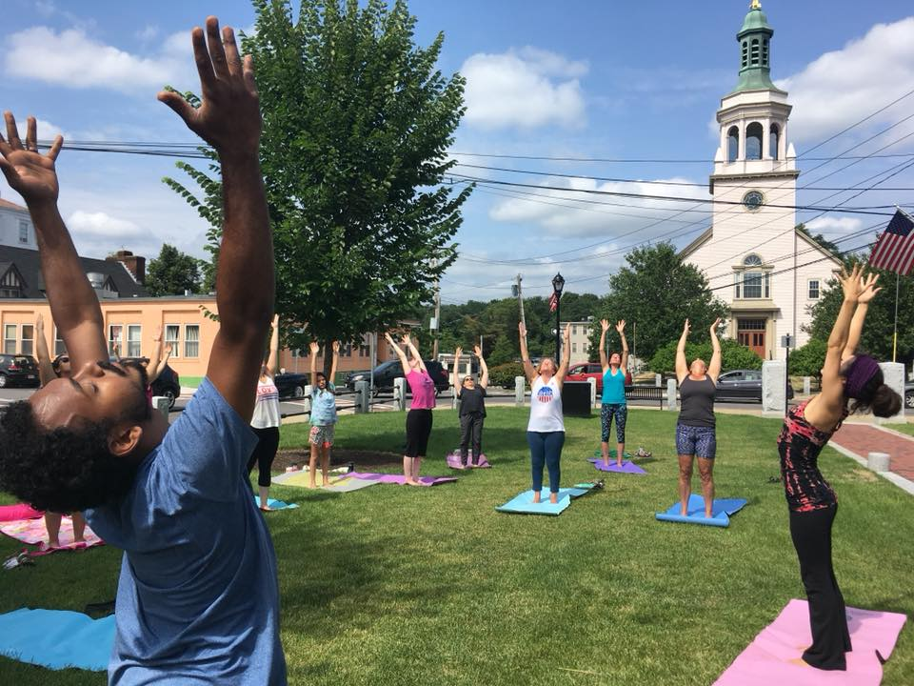
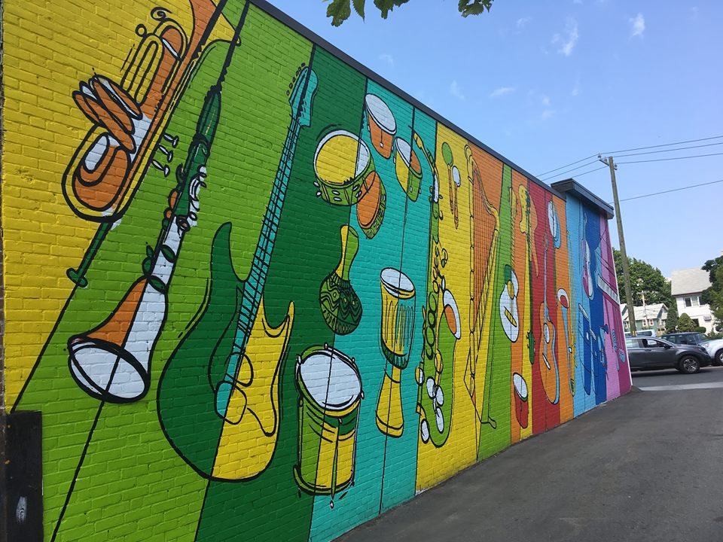
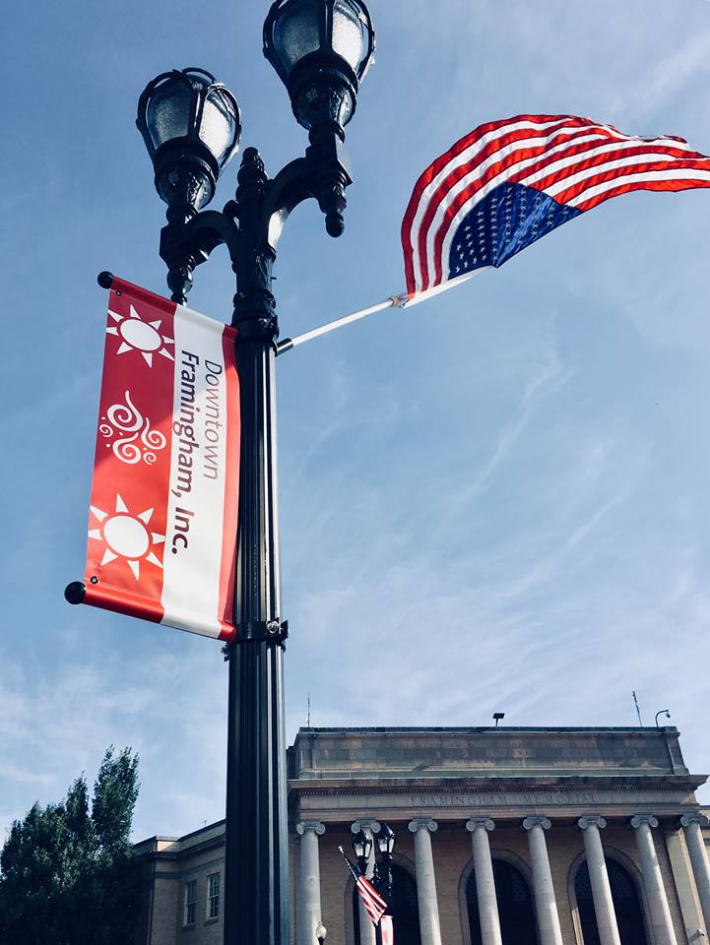
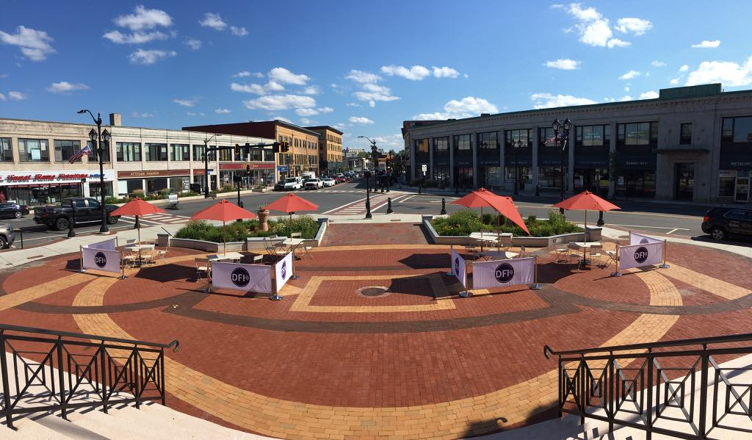
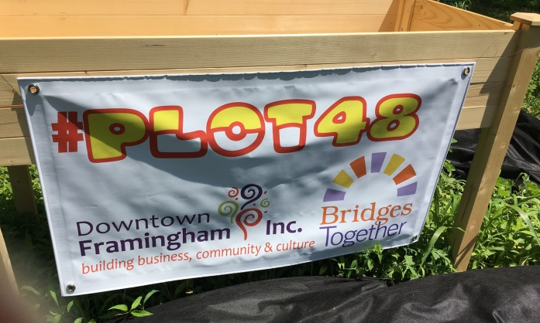
IMPACT Spatial Use Beautification / Placemaking

Slide 24
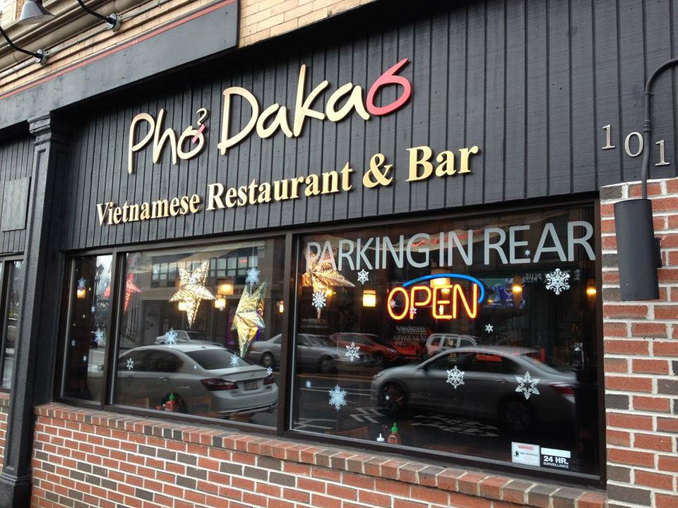
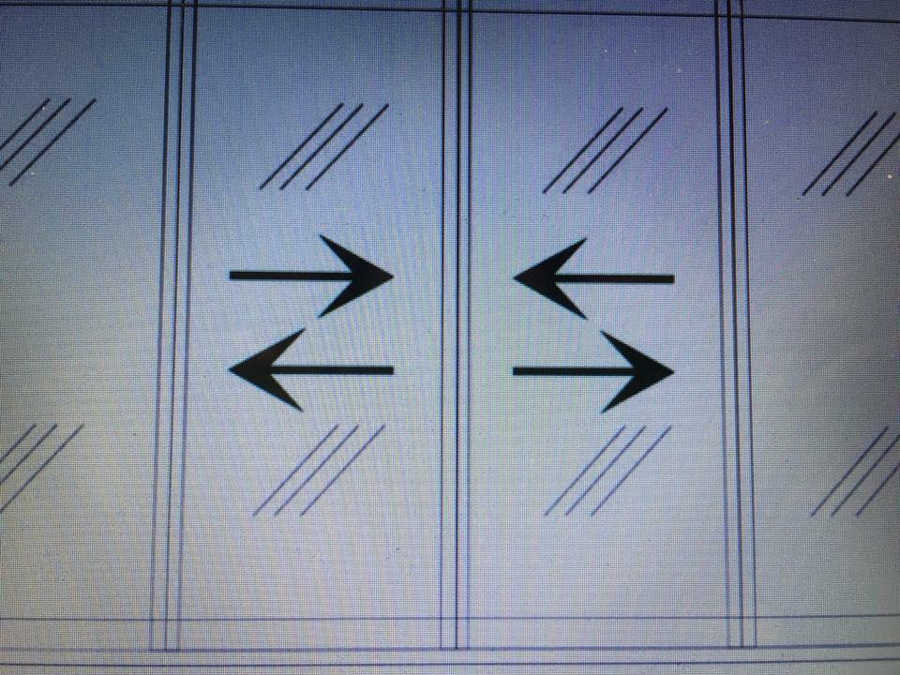
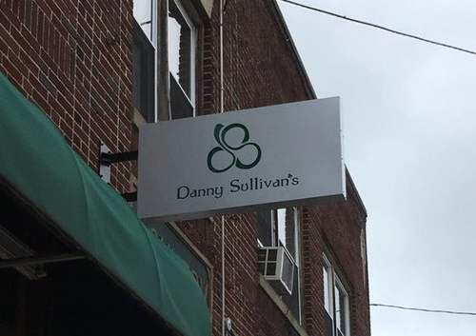
IMPACT
BIZ SUPPORT FOR BEAUTIFICATION / BRANDING
FACILITATE SIGN AND FAÇADE PROGRAM
BRACKET SIGNS
FAÇADE PROJECTS

Slide 25
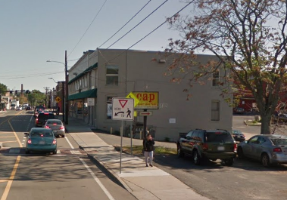
2020 Placemaking / Beautification Projects
Street-level ambiance
Speakers on street lamps – will NOT be funded by Bose
Holiday Lights
Lights outlining landmark buildings (insurance, safety issues)
Implement Sidewalk Usage Ordinance
Test at Oktoberfest
Advance Wayfinding Signage
Test at Oktoberfest
Framingham Station Plans
Harmony Grove Arch with illustrations
301 Howard Street Park
Umbrella Sky Project
Tree Animals
Lit-up Furniture
Mural on Waverly

Slide 26
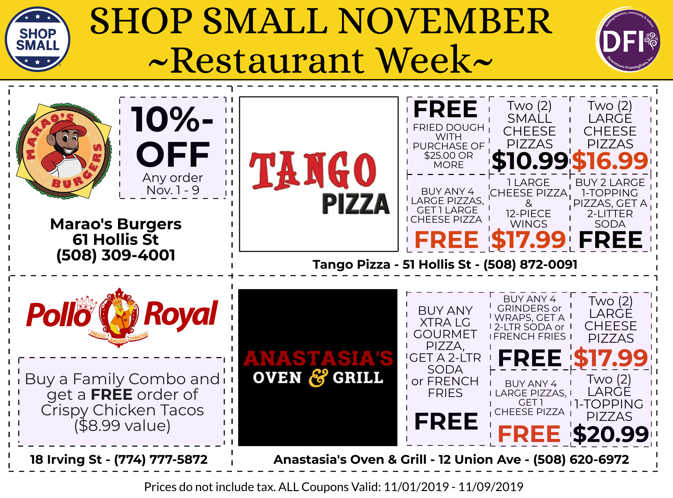

Slide 28
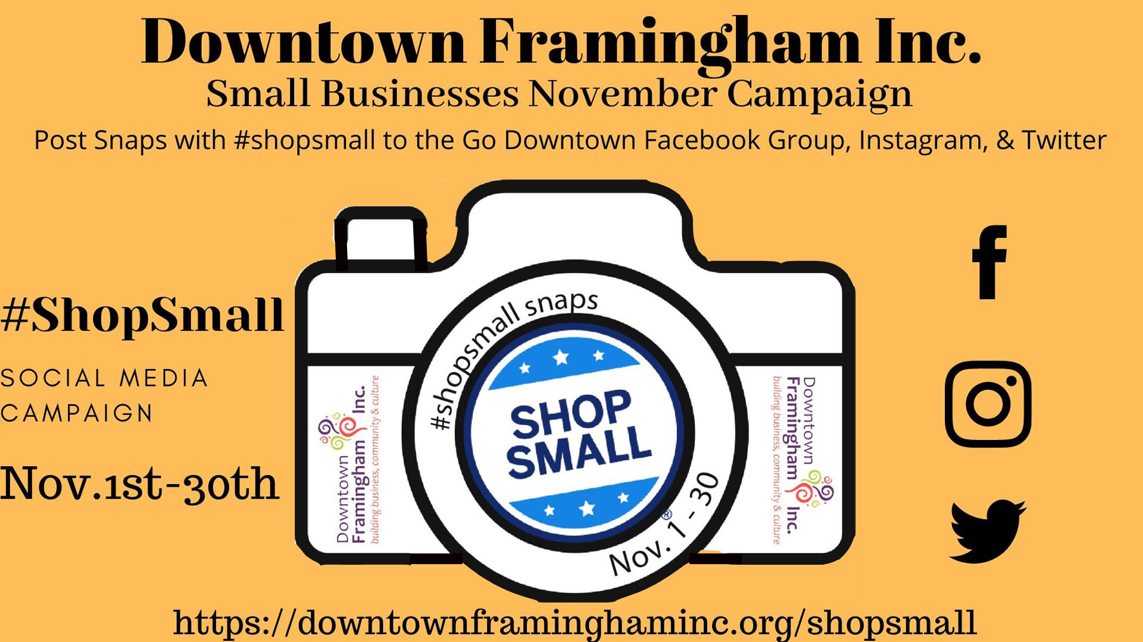

Slide 29
Thank you!
courtney@downtownframinghaminc.org

